Slide 1

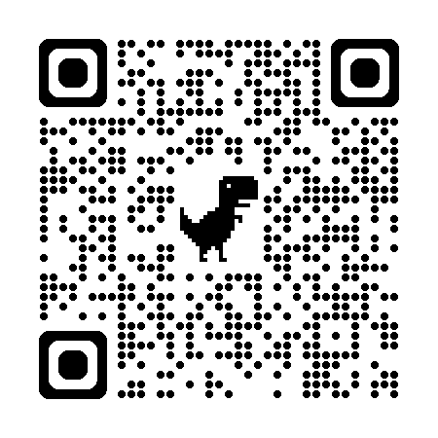
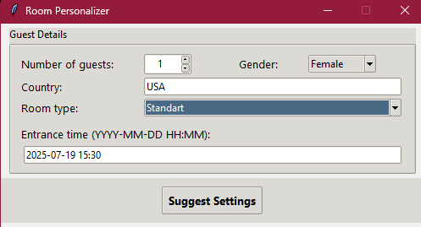
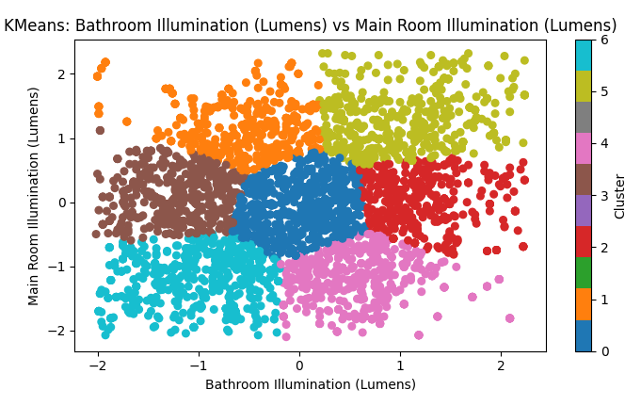
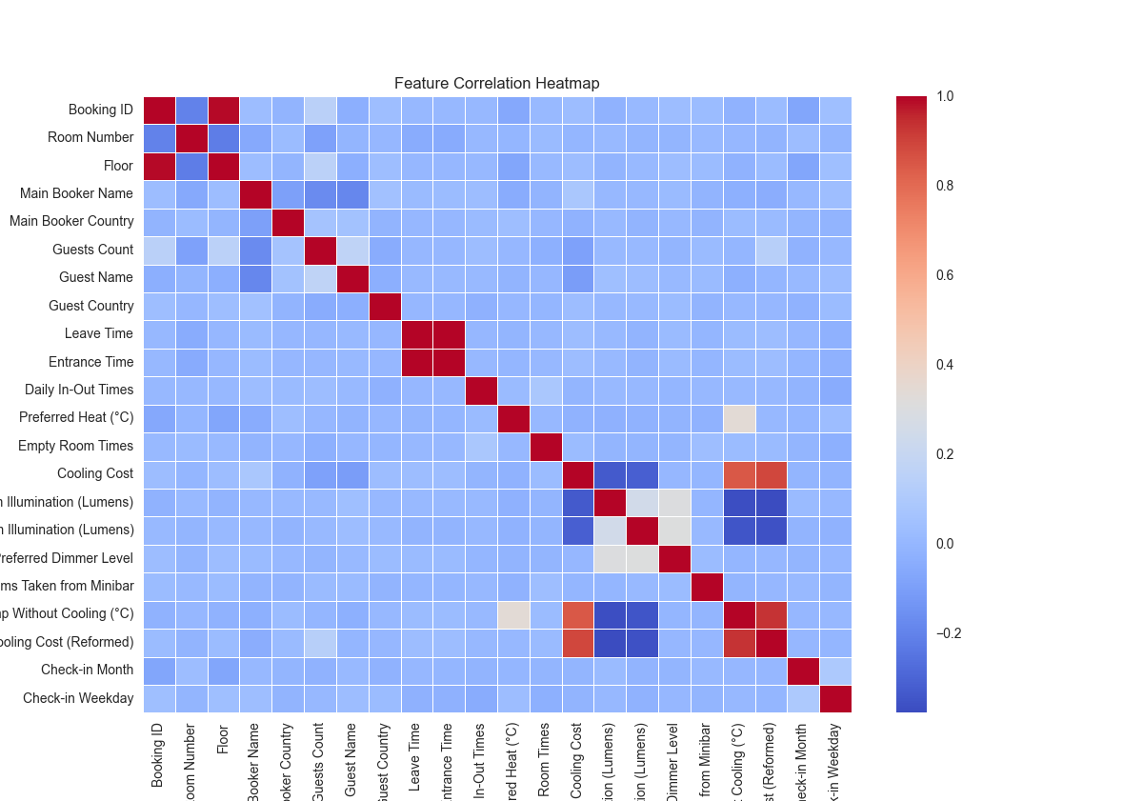
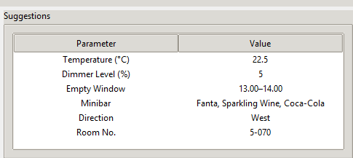
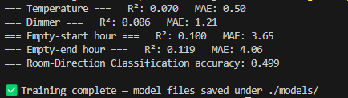
Smart Stay: AI-Driven Guest Segmentation
Doğukan Günal
2025 /42
“Funding Information”
Information”
Information”
Abstract
Methodology
GUI Integration: All models were incorporated into a GUI that accepts guest info, processes it with the saved pipeline, and instantly returns room suggestions like minibar preferences, temperature, suggested Room ID.
Figure 3: Room personalizer user interface and required informations
Visual & Pairwise Validation: Specific feature pairs such as "Gender vs. Heat Preference" or "Direction vs. Cooling Cost" were clustered separately to confirm model assumptions visually.
The Smart Stay project utilizes advanced data analytics to enhance hotel operations and guest experiences by personalizing room settings and optimizing energy use. A comprehensive dataset was created, integrating guest profiles, room characteristics, minibar usage, entry-exit logs, and environmental factors. Through meticulous preprocessing and feature engineering, clustering techniques like K-Means, DBSCAN, and Agglomerative Clustering are tested and if needed implemented using Python libraries (PyCaret, scikit-learn, mlxtend, Apriori). K-Means clustering yielded clear, actionable segments, revealing guest behavior patterns and operational efficiencies. Association rule mining identified minibar consumption preferences linked to guest clusters. Predictive models were developed using Random Forest and Linear Regression to estimate guest preferences for temperature, lighting, empty-room intervals, minibar choices, and optimal room orientation. These insights were consolidated into a Room Personalizer GUI, providing staff with real-time, data-driven recommendations for guest-specific room settings, significantly improving comfort and reducing operational costs.
Dataset Construction: A dataset was manually built in Excel, simulating real hotel conditions. It included guest demographics, room features, environmental factors, and minibar behaviour.
Clustering and Scaling: The dataset was standardized using StandardScaler, followed by clustering via K-Means, which was selected for its clarity in segmentation. A seven-cluster structure was determined optimal. DBSCAN and Agglomerative Clustering were evaluated for validation but found less effective for this context.
Figure 1: Kmeans method clusterization example
Correlation Mapping: Realistic links like west-facing rooms tending to have higher temperatures were documented to inform model structure. These helped validate clustering patterns and support feature logic.
Figure 2: Correaltion map between room features (except minibar preferences)
Minibar Preference Mining: The Apriori algorithm was applied to one-hot encoded minibar selections to extract frequent itemsets. Rules like "Cluster 3 → Chocolate, Wine" were stored for use in real-time minibar recommendations.
Predictive Modeling: Using Random Forest Regressor and Linear Regression, models were trained to forecast room temperature, dimmer level, preferred room direction and the daily window when rooms are likely unoccupied. Cluster IDs were included as predictive inputs to improve context based on guest and reservation data. This enabled smart room number assignment suggestions.
Figure 3: AI model outputs
Results and Dıscussıon
The Smart Stay project produced a working system that recommends personalized room settings using clustering and predictive models. K-Means effectively segmented guests into seven distinct behavioral clusters. Regression models predicted temperature with 0.5°C mean absolute error and lighting with 1.2% error. Minibar preferences were mapped per cluster using Apriori rules, and direction classification reached ~70% accuracy.
Table 1: Suggested parameter outputs
Background
The hospitality industry continuously seeks ways to improve guest satisfaction and operational efficiency while managing environmental impact and costs. Hotels typically face challenges in accurately predicting guest preferences, which often leads to increased resource consumption and missed opportunities for personalized guest experiences. In response to these challenges, the Smart Stay project was initiated to leverage cutting-edge data analytics techniques. By integrating diverse data sources including detailed guest profiles, room features, operational logs, minibar usage, and environmental metrics this initiative aims to uncover deep insights into guest behavior and preferences. Utilizing sophisticated machine learning approaches and clustering algorithms, the project provides actionable intelligence to optimize guest comfort, reduce operational expenses, and enhance overall hotel efficiency.
Conclusion
Smart Stay proves that clustering, regression, and rule-based analytics can quickly convert hotel data into practical, guest-level room recommendations. With clear cluster separation, sub-degree temperature error, and an intuitive GUI, the prototype already is in decent condition. Our findings echo recent literature while extending it with an integrated, cross-domain approach.
Future Work
Next steps include testing Smart Stay with live sensor data, refining models through continual learning, and expanding features to cover air-quality and occupancy sensors. Integrating mobile check-in and real-time feedback will further personalize settings and validate energy savings at scale
Acknowledgements
This project was carried out under the supervision of Prof. Dr. Asım Egemen Yılmaz. I sincerely thank him
for his invaluable guidance and contributions throughout every stage of the work.

